Slide 1
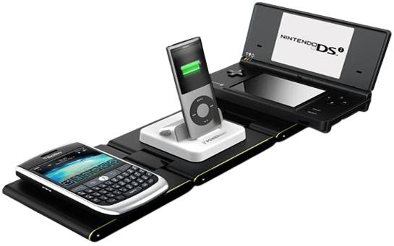
Inductive Technology

Slide 2
Wired charging requires dragging a long data cable, which is ugly and has no sense of technology at all.
For wireless charging, you only need to gently lean the phone on the charger, and the current will be continuously charged into the phone immediately.
Wireless charging (Inductive charging) uses an electromagnetic field to transfer energy between two objects. This is usually done with a charging station.
Mobile Charging
Laptop Charging
Electric vehicles Charging
Applications :

Slide 3
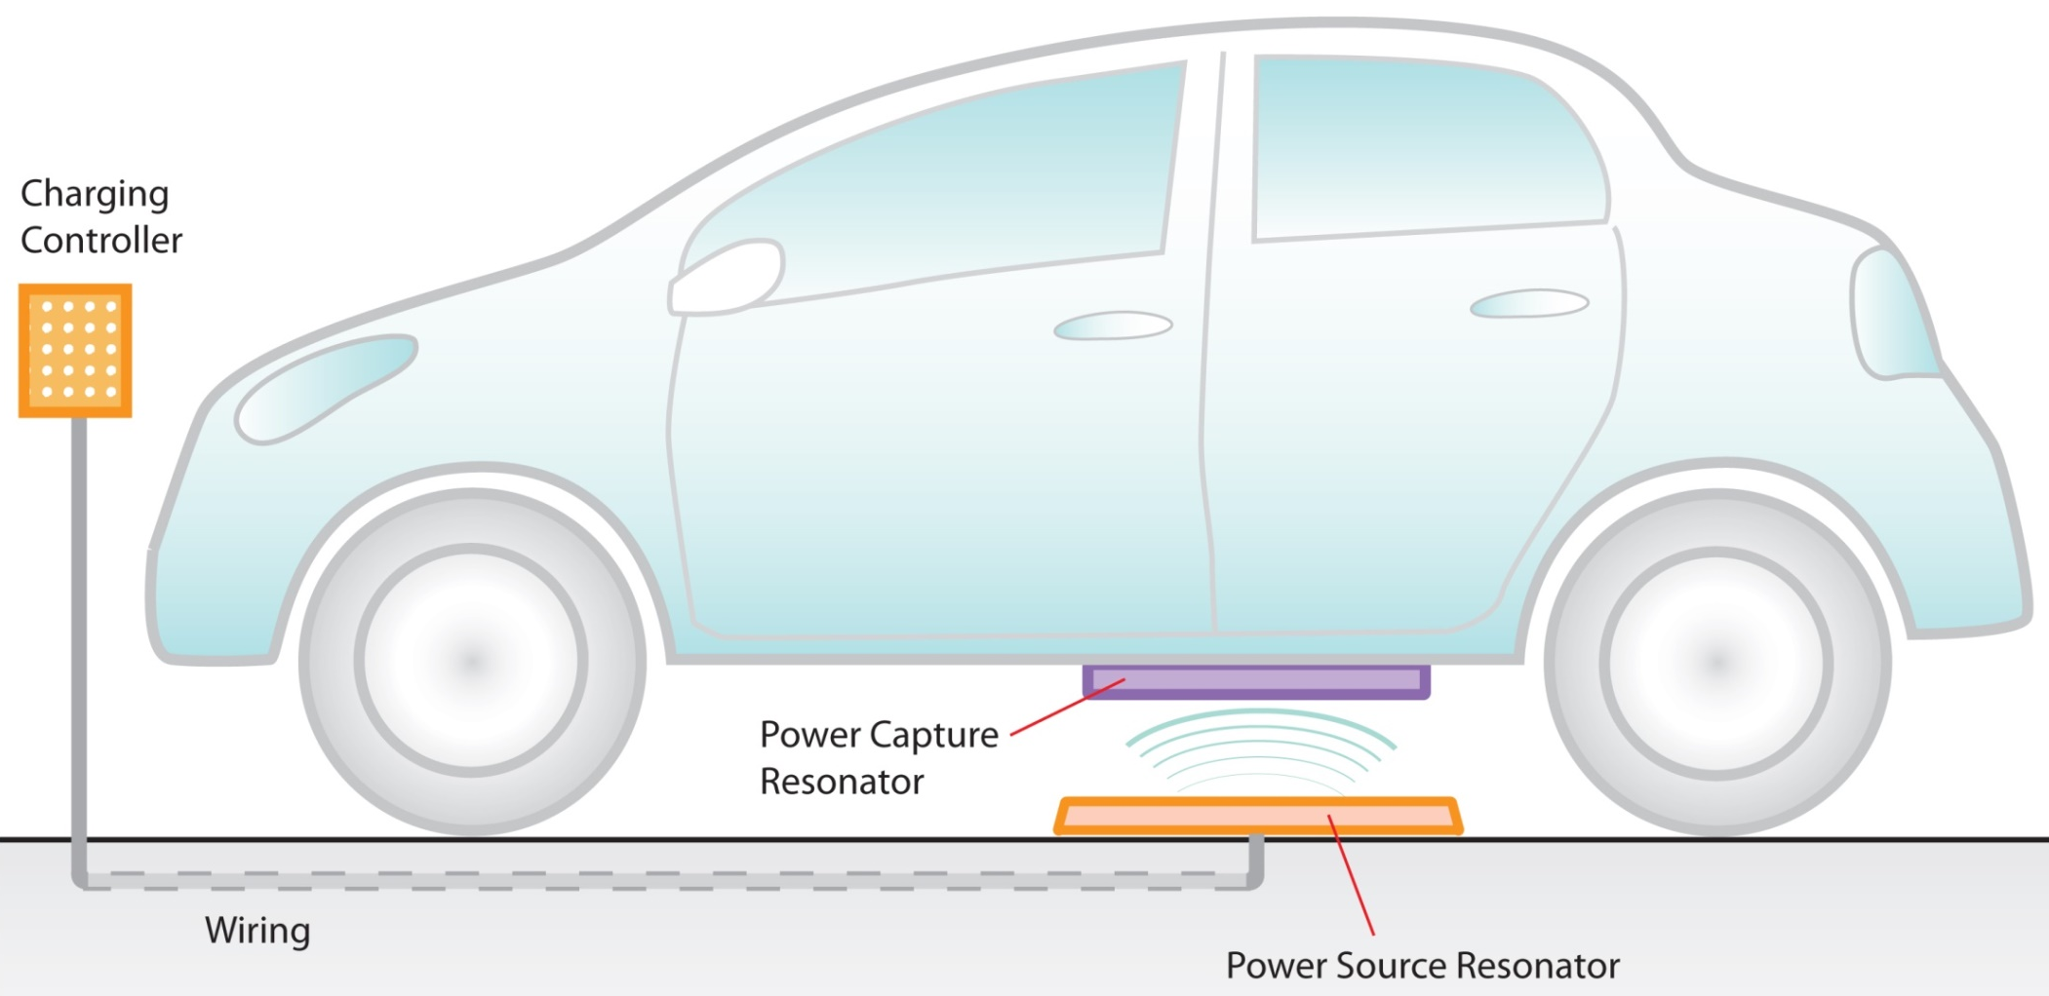
Electric vehicles Charging

Slide 4
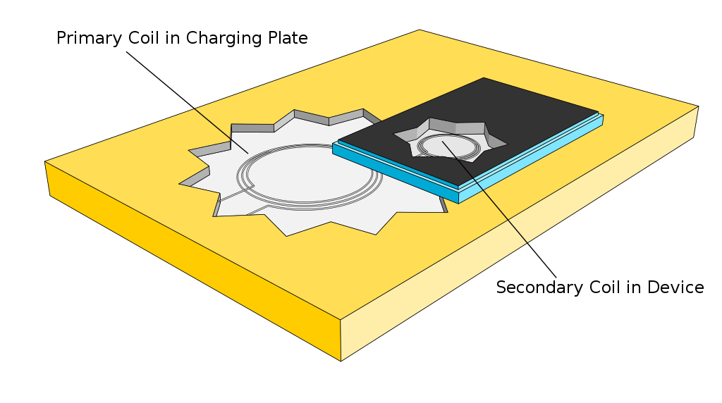

Slide 5
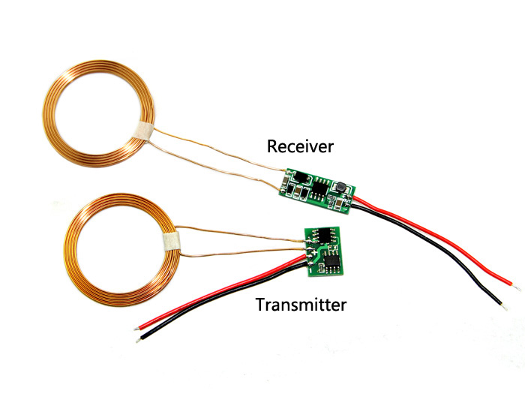

Slide 6
Advantages :
Wireless
A number of device can be charged at a time
Electrically safe
Waterproof
Low maintenance
Convenient Charging
Durability

Slide 7
Disadvantages :
Lower efficiency, waste heat
Slower charging
More costly

